Slide 1
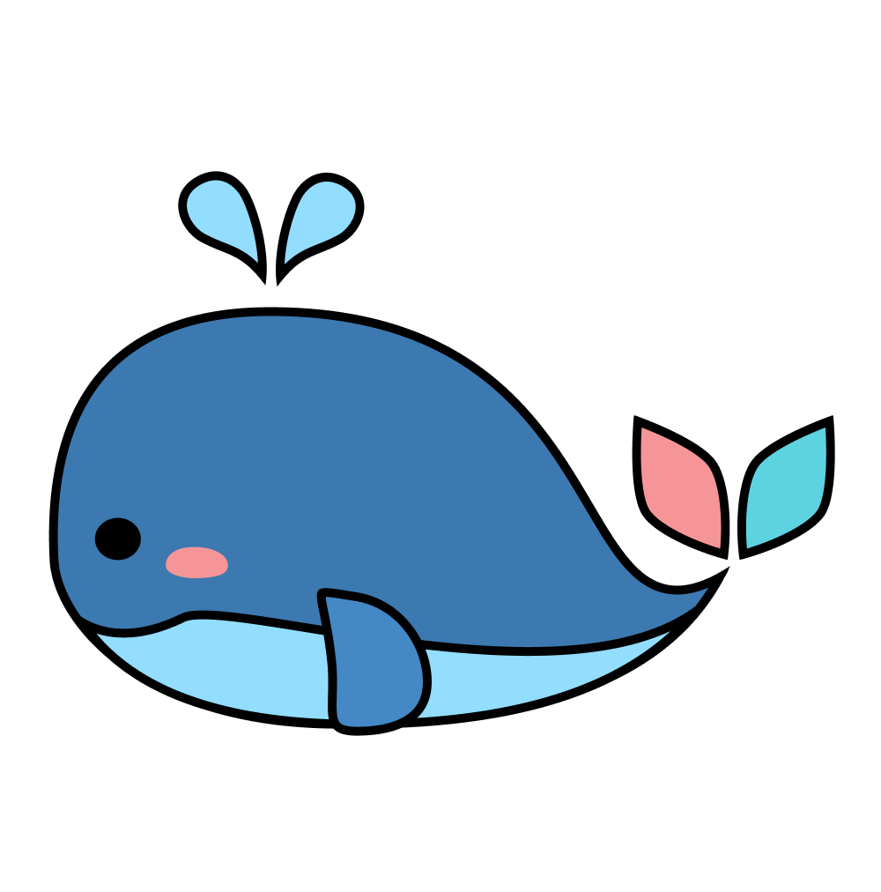
Second Internal Check
By Team Pinocchio
Notes:
Good evening, we are team Pinocchio and we are here today to update everyone about how we are doing after the first internal check.

Slide 2
Table of Contents
Software Application
Impact & Implementation
User Feedback
Notes:
Today, we will first talk about the software application, introducing our finalized design, user interaction, and live demo. Then, our marketing team will talk about the impact and implementation of Pinocchio, and also go analyze the beta user feedback we collected

Slide 3
Software Application
Notes:
So without further ado, let us move to software application

Slide 4
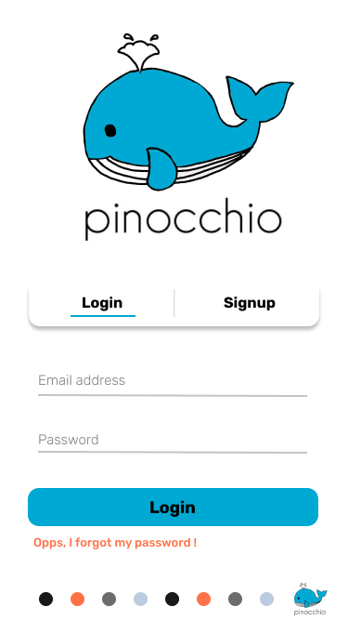
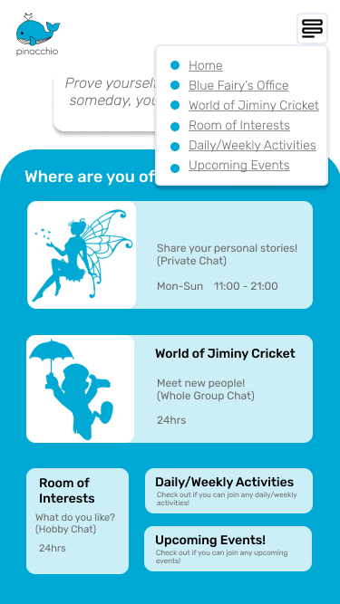
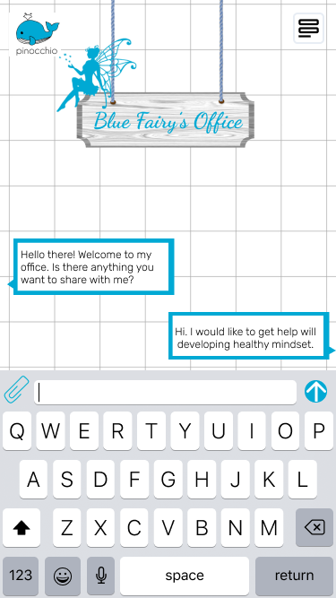
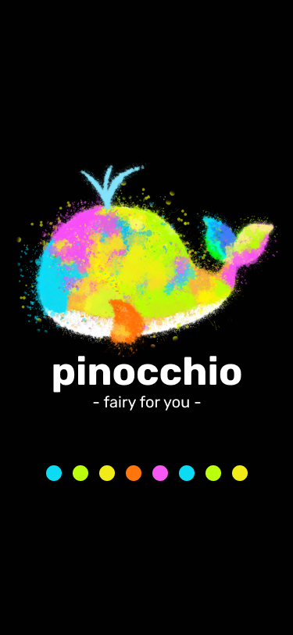
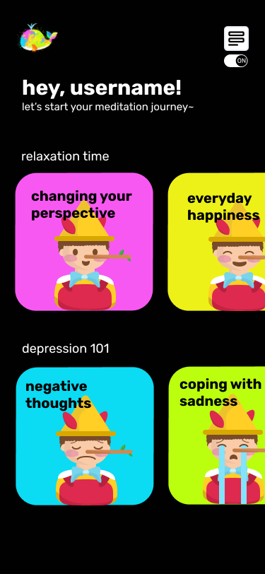
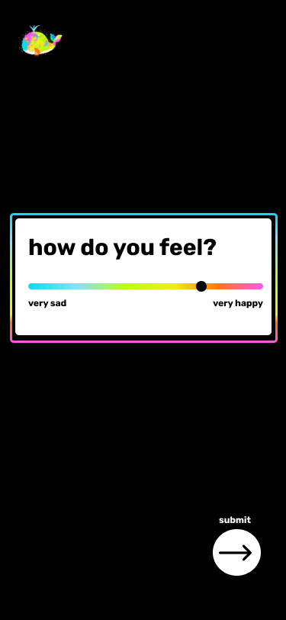
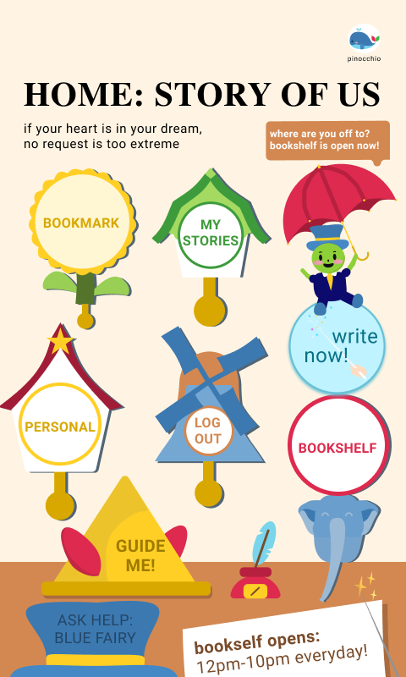
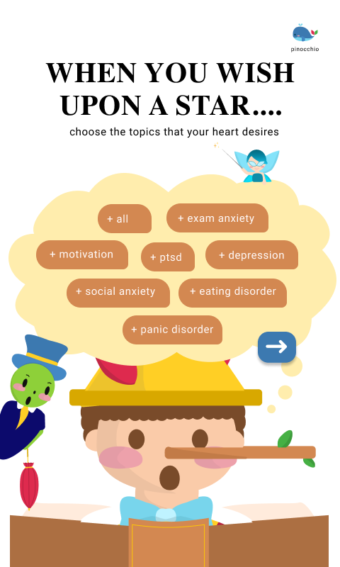
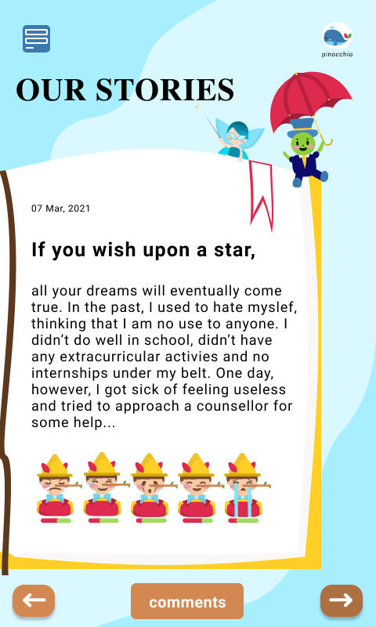

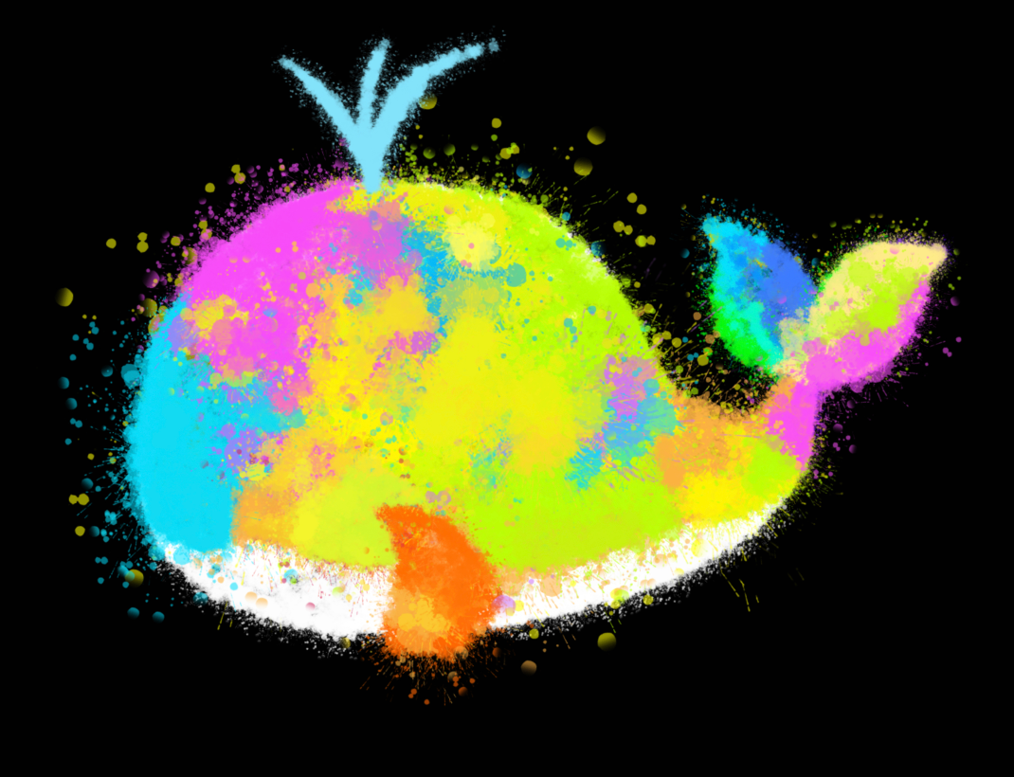

Changes Made
What next?
1:1 Private Chat(App):
Not feasible
Demands heavy manpower
Meditation + game (App):
Exists already(not unique)
Too many at once
2 different color scheme
Online Forum (Website)
Design is too childish and messy
Notes:
Before we show the final version, we thought it would be worth mentioning how our project has evolved to provide a better solution for the psychological well-being of students in HKUST. (click) Our very initial idea of Pinocchio was to launch a 1:1 private chatting app with a mentor so that students can easily seek the help of counselors at any time. Yet, we soon realized that this is not only feasible since it requires heavy manpower but also because the wellness center is offering a hotline as well as similar services, there is no need to launch such a project. Therefore, (click) we decided to create a meditation app that has a gaming feature attached to motivate people to use our app. However, since we now can easily get a better meditation guide through Youtube and other professional websites, and thus because our app would not be as unique even if gaming features are there, we decided to change. Furthermore, what we noticed as we asked for feedback and talking with our technology mentor, Kris, was that people may not be encouraged to download an app that can take up their storage. Hence, (click) we decided to change into a website, and launch an online forum instead of providing a 1:1 chat or meditation service. Tiffany will now further elaborate on the reason why we decided to launch an online forum.

Slide 5
MEETING NEEDS OF COMMUNITY
CUSTOMISED FOR HKUST STUDENTS
Hole in student-to-student support system
Creates an open atmosphere for students to discuss taboo topics
Build a supportive community
Based on past surveys, we have made changes to the website to make it more suitable for HKUST students:
Community
Popular Topics
Design & Features
next

Slide 6
WHY ONLINE FORUM WORKS?
Case Study: HealthyPlace.com
“The conversation, although typed and not face-to-face, were however spontaneous and genuine conversations”
A sense of community is formed
Anonymity allows freedom of identity → Individuals can speak freely among encouraging audience
Most common interaction was to find support and information about depression
(Bellissimo)

Slide 7
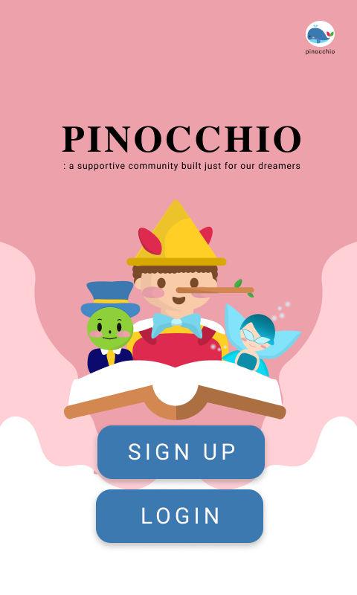
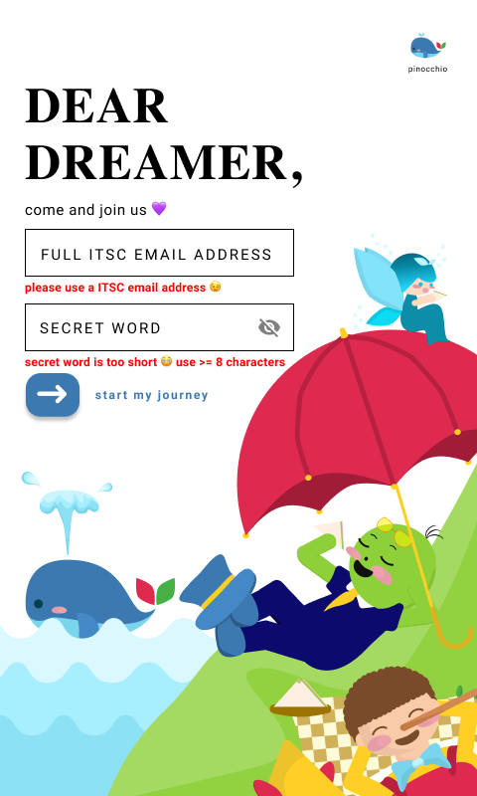
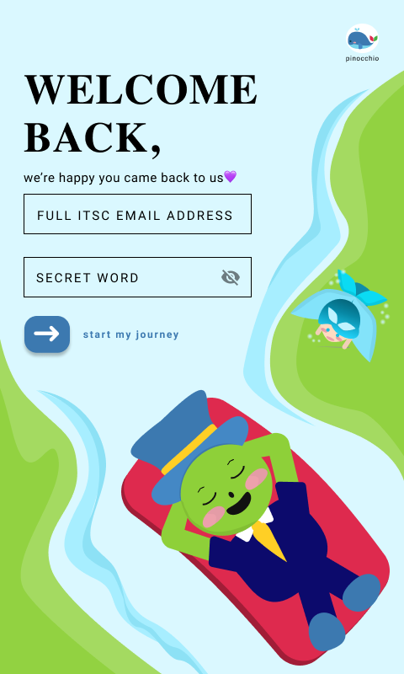
What next?
But still… the design is:
too childish
Messy
Complicated to follow
Too many characters
A bit over energetic
Notes:
Although our features were now much better, we got feedback from our potential users that the design is a bit messy and childish. Also, some people noted that it may be too energetic for users who are mentally tired, which may bring adverse effects. Furthermore, since there were two more characters, blue fairy, and jiminy cricket which might not be familiar to those who do not know Pinocchio’s story well, the design could be confusing. Thus, we decided to change our design to make it more intuitive and simpler.

Slide 8
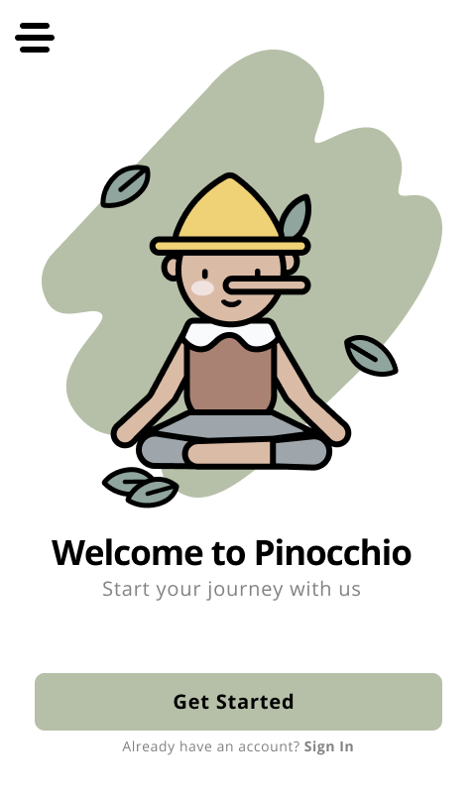
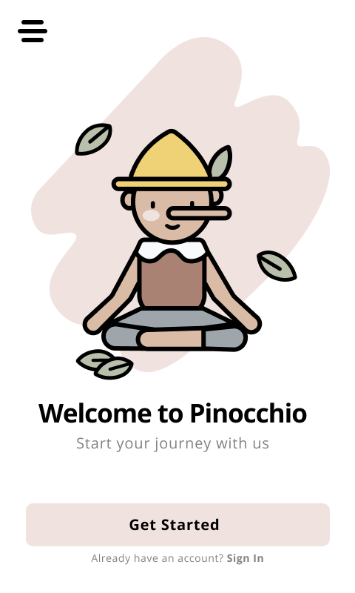
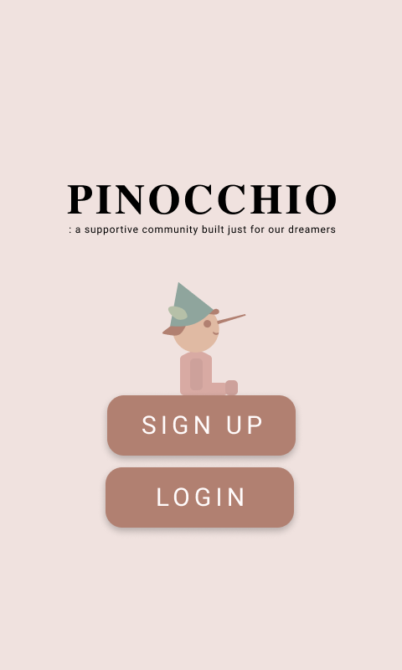
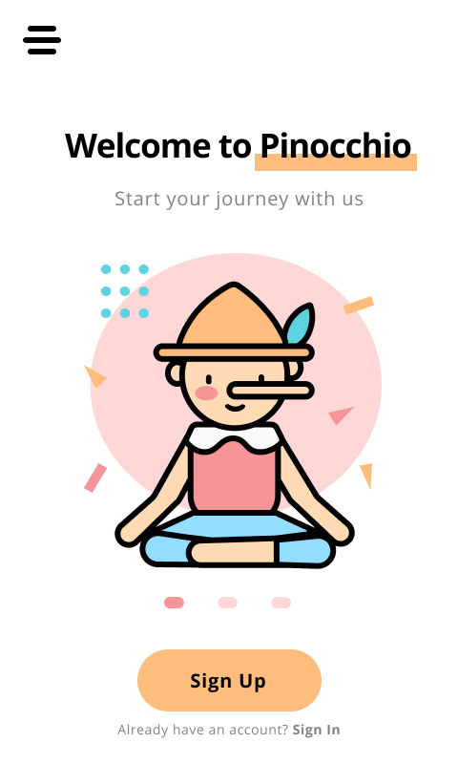
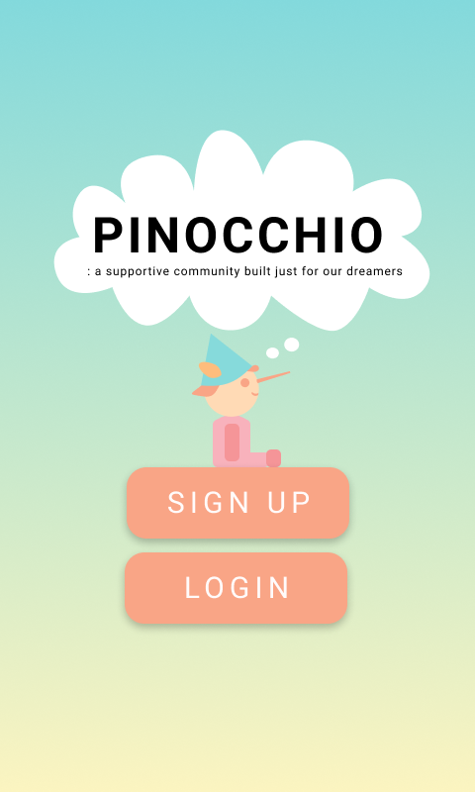
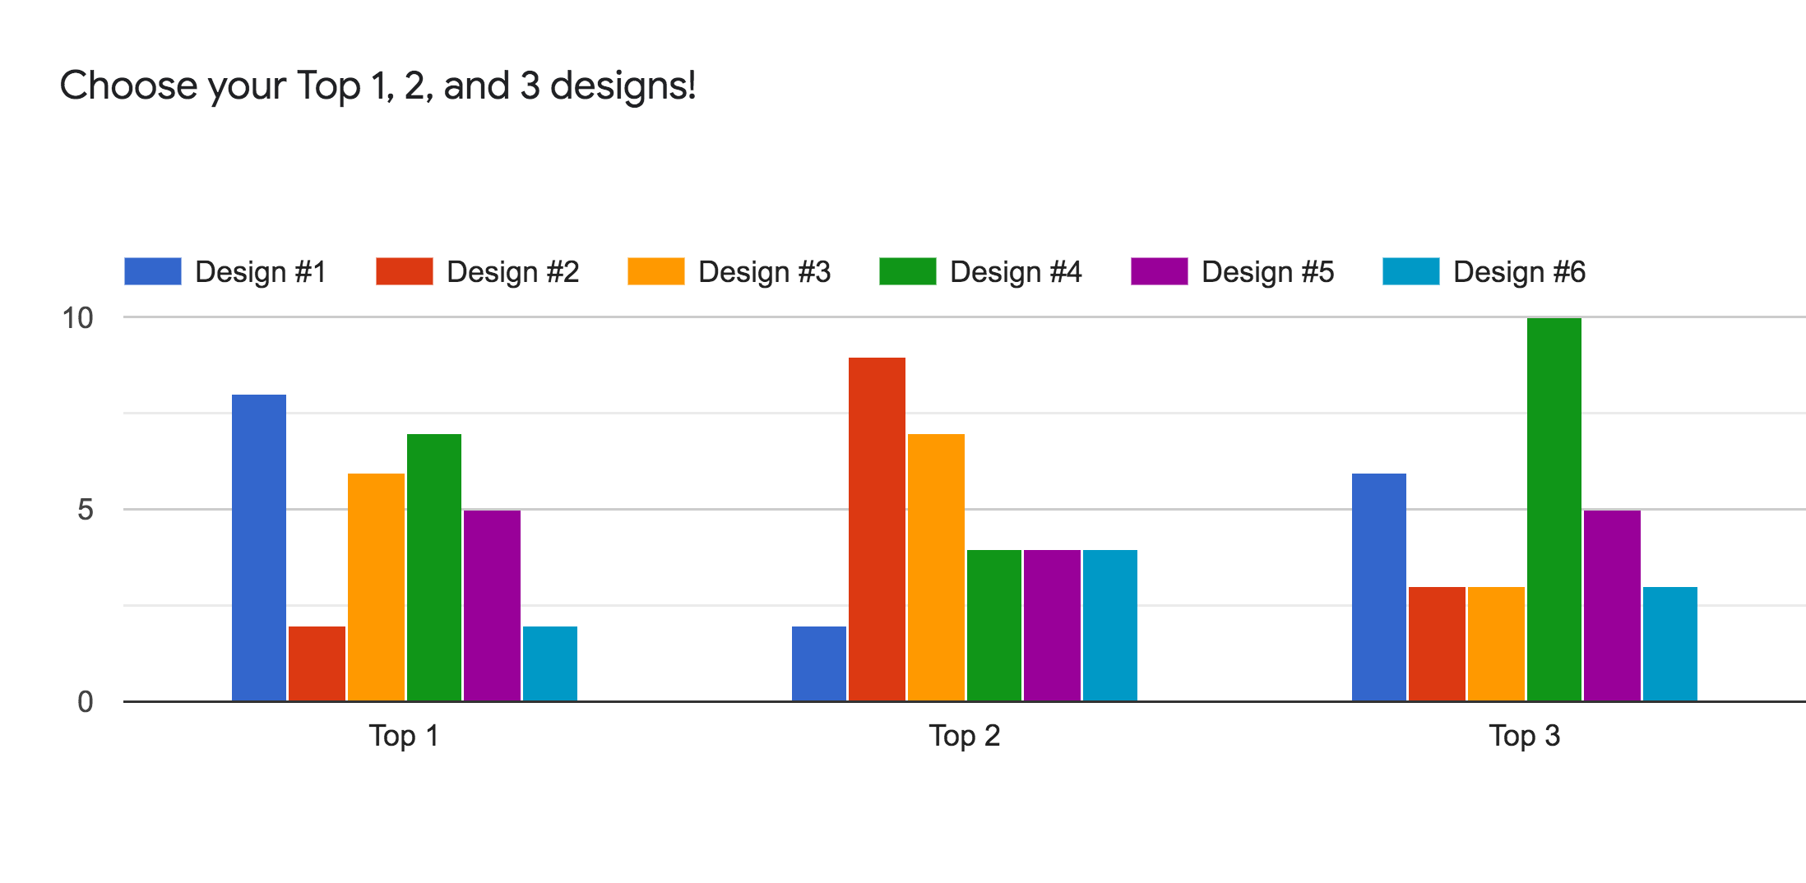
 | Top 1 | Top 2 | Top 3 | total
Design 1 | 8 | 2 | 6 | 16
Design 2 | 2 | 9 | 3 | 14
Design 3 | 6 | 7 | 3 | 16
Design 4 | 7 | 4 | 10 | 21
Design 5 | 5 | 4 | 5 | 14
Design 6 | 2 | 4 | 3 | 9
Notes:
We came up with 5 other designs and asked people to vote. The first 3 designs use more calm but dull colors, and designs 4 and 5 use more bright pastel colors. Design 6 is the previously designed one. We asked 30 potential users and the results were (click) this. Design 1 was chosen as top 1 by 8 people, however, design 4 had the highest overall voting, earning 21 votes. Thus, in the end, (click) we chose the fourth design as our final design.

Slide 9
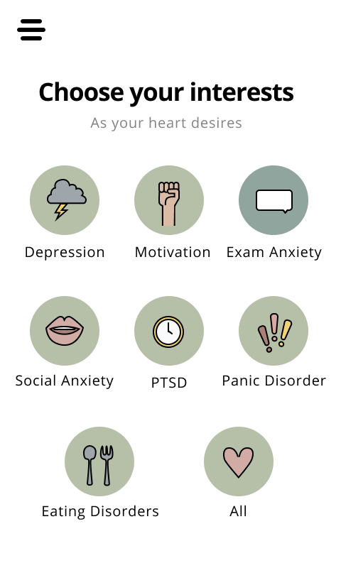
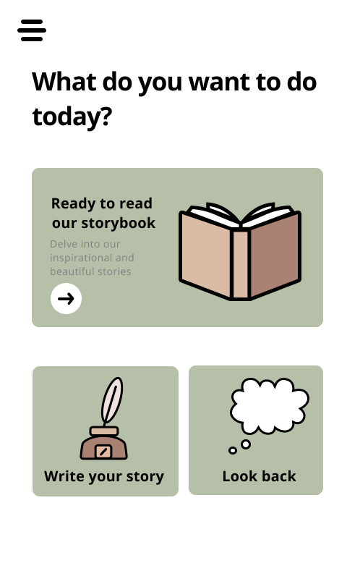
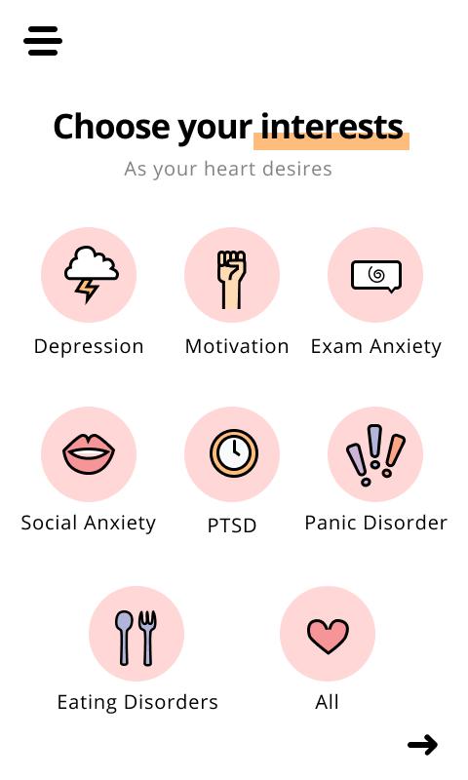
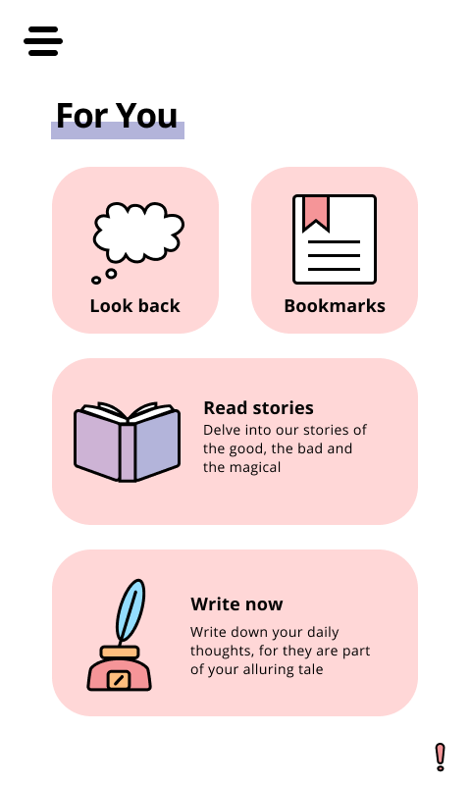

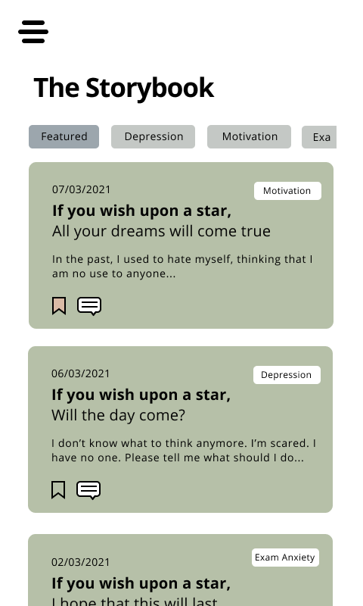
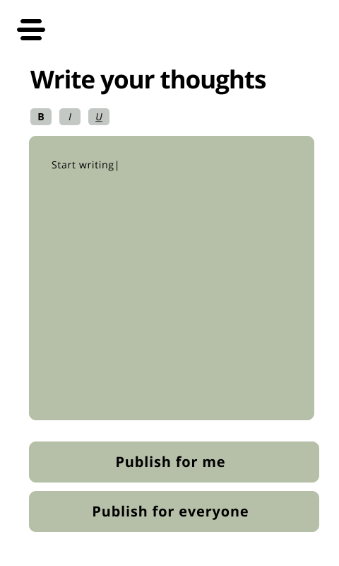
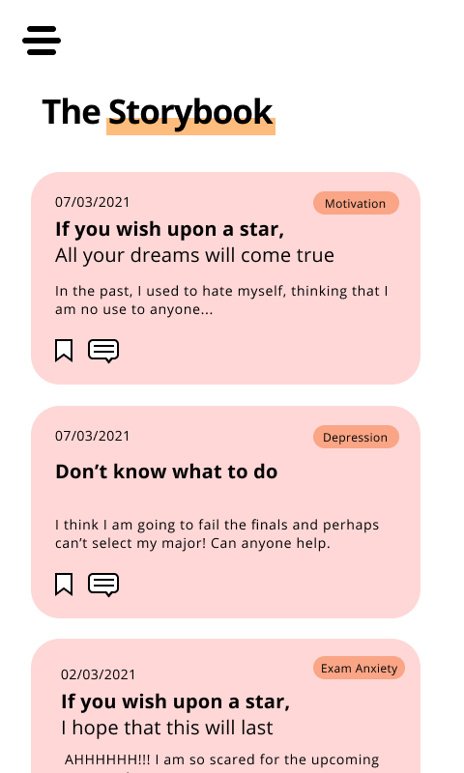
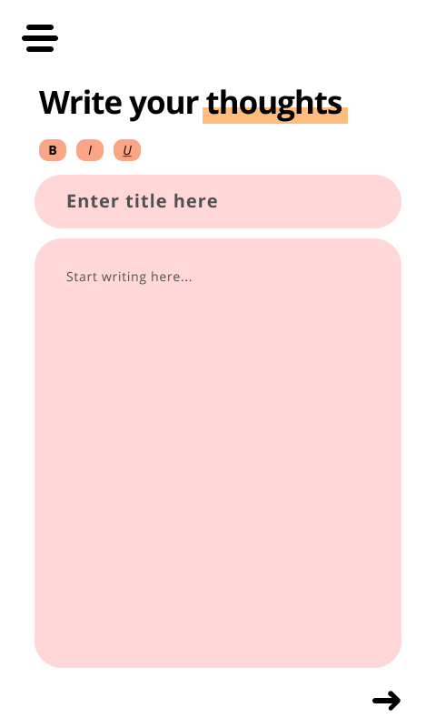
Why Design 4 not 1?
Brighter color
According to research:
Bright color: used in color therapy to change people’s mood
Dull color: used by depressed people
Notes:
Not only due to the voting but there is another reason behind deciding our final design. Many researches published in health professional websites including US National Institute of Health showed that color therapy uses brighter colors to change people’s moods, or even heal emotional problems including depression. Whilst dull color is what depressed people use to portray their emotion, which therefore can make people get depressed even more if they consistently see the dull color through our website design. Therefore we chose design 4.

Slide 10
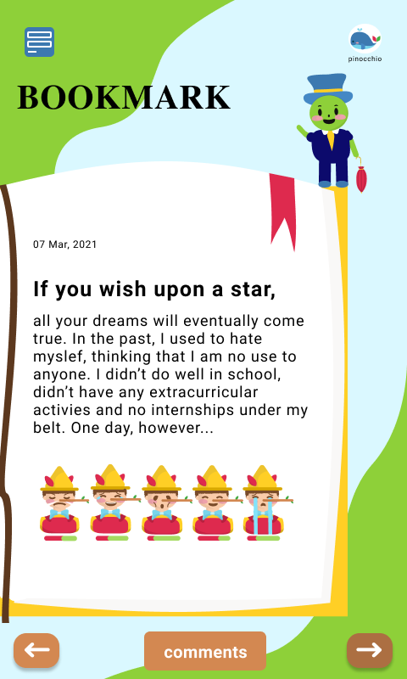
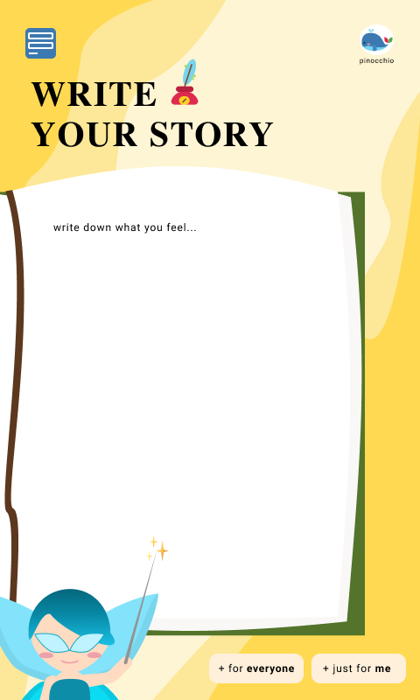
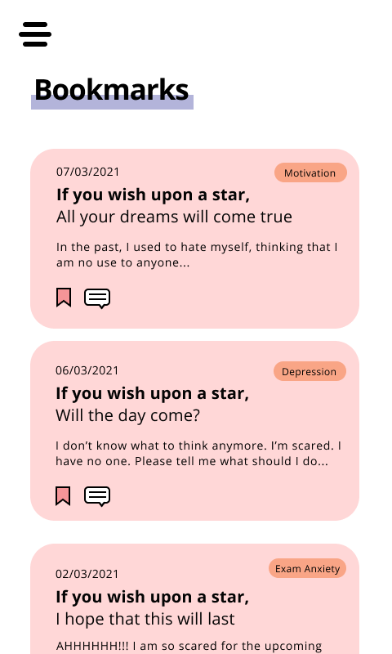
Our New Design is:
Less childish
Not too energetic
Not too dull
Easier to follow
Simpler UI
Ex: Home Page
Less characters
Notes:
Now comparing with our previous design, our new design was able to fix all the drawbacks of the past design; and therefore it is less childish, not too energetic but not too dull as well, and simpler. In fact, people who chose design 4 said that what they like about the design is its simplicity and pastel colors.

Slide 11
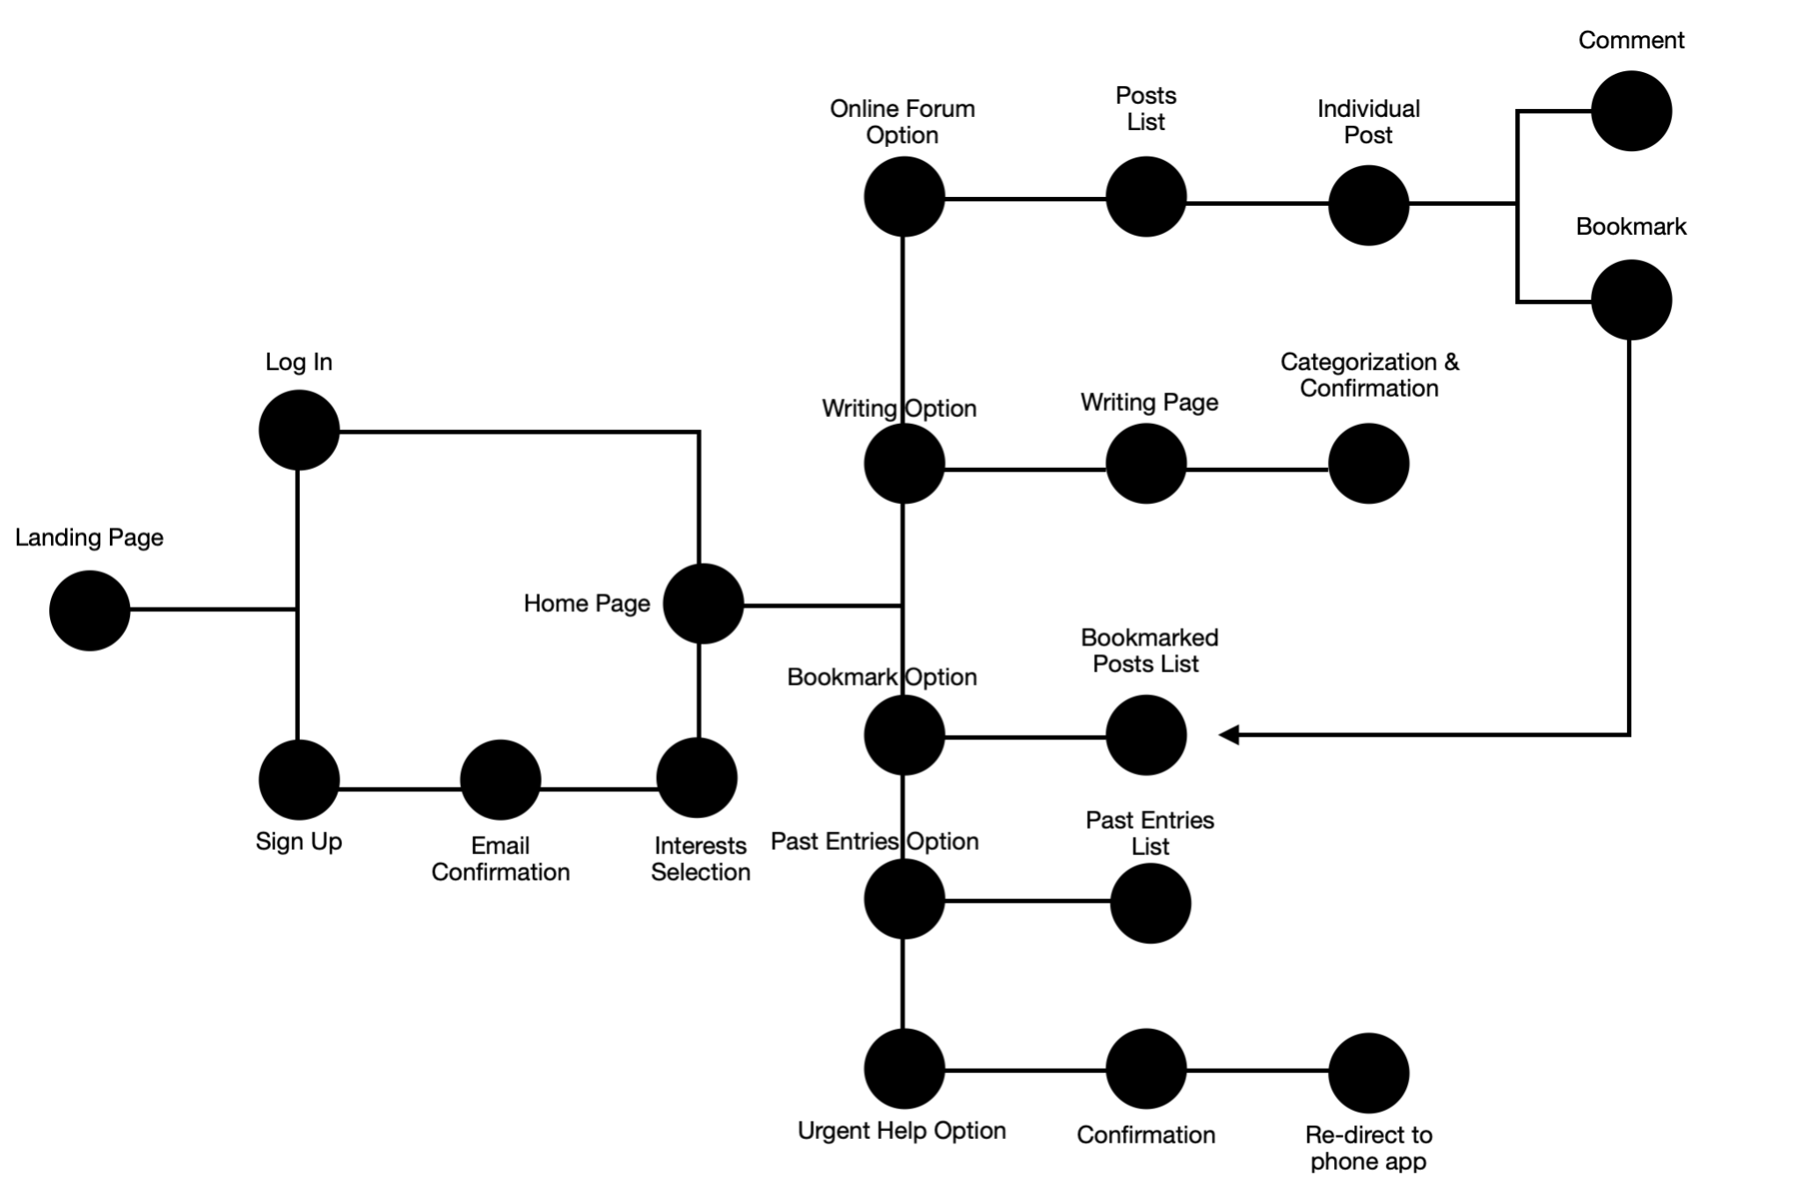
USER INTERACTION

Slide 12
USER INTERACTION

Slide 13
USER INTERACTION

Slide 14
USER INTERACTION

Slide 15
USER INTERACTION

Slide 16
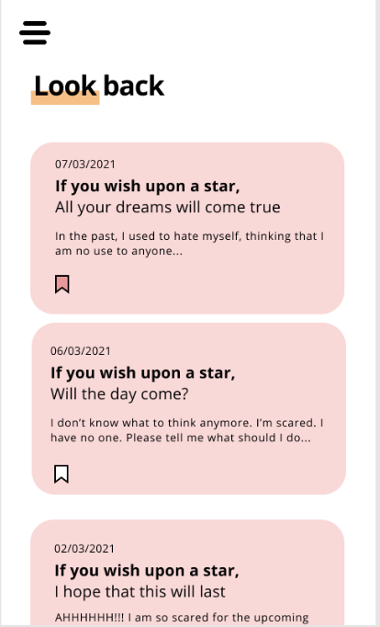
USER INTERACTION

Slide 17
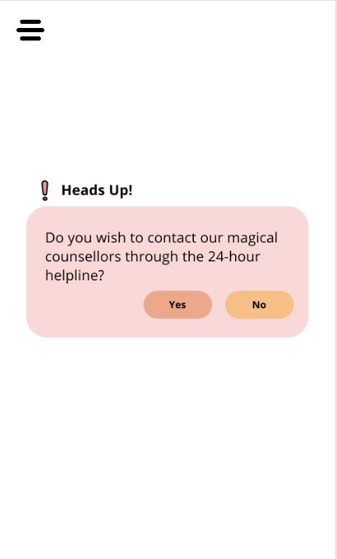
USER INTERACTION

Slide 18
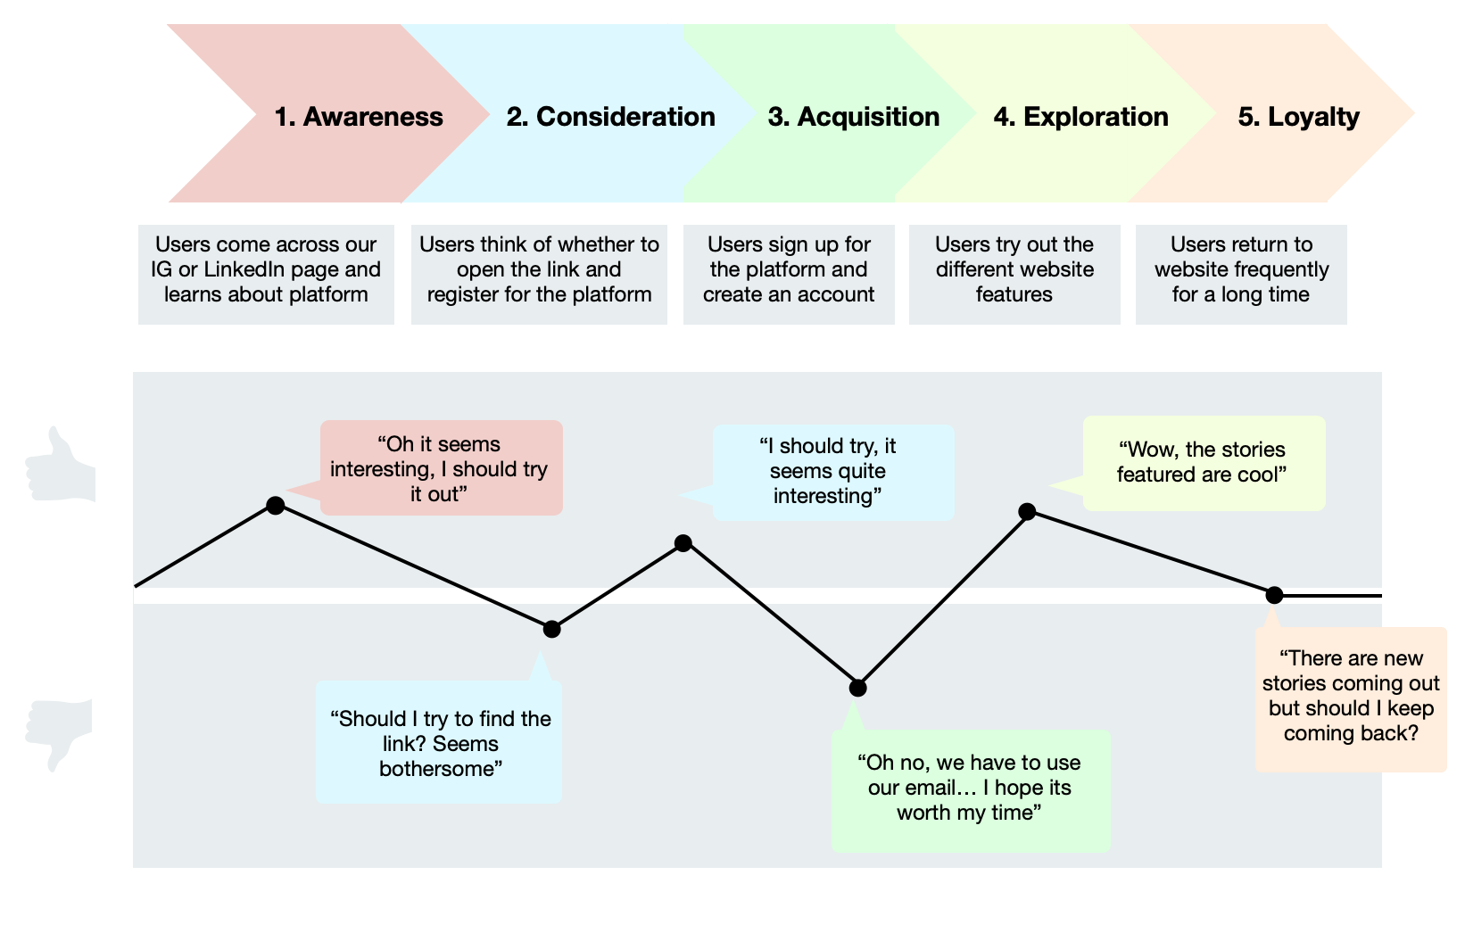
uSER JOURNEY

Slide 19
uSER JOURNEY

Slide 20
uSER JOURNEY

Slide 21
uSER JOURNEY

Slide 22
uSER JOURNEY

Slide 23
Upcoming Developments
Beta Testing
Refine
Development
Web Version
Toxicity Check
Chinese Translation
Notes:
For the upcoming development of the platform, it would be a loop consisting of beta testing, refinement and development. We will try to include more people in the coming beta-testing. And from the feedback we will refine our website to improve user interface and user experience. For development, our top priorities are web web version, toxicity check and chinese translation.

Slide 24
Impact
&
Implementation

Slide 25
IMPACT + IMPLEMENTATION
01
02
03
Measuring Behavioural Changes to our Forum
Marketing Plan
Making our Project Sustainable

Slide 26
Marketing plan
Date | Tasks To Do
April 9 | Launching soon post will go up on Instagram Repost by Pinocchio team members Creating posts to post for the following few days - this would include posts including answering why, who, what, where, when and how of our app, the features we have and the deeper meaning behind Pinocchio
April 10 | Start posting each of these posts every day one-be-one. Additionally, we will start reaching out to some of the accounts mentioned above
April 11 | Reach out to the remainder of accounts (those that are related to the school will have to be sent via email).
April 12 | Continued posting all of the posts mentioned on April 9th.
April 18 | This is when each team member will post on linkedin about their experience on this project and what they are looking forward to.
April 19 | Sending out a mass email at this point (requesting both SiGHT and EC to help) to spread awareness around the university would be great too.
April 20 | Possibly having our group members do an IG takeover, one everyday leading up to the launch would be cool so that they can see a real side to those that created this and why.
April 24 | LAUNCH!

Slide 27
Behavioral Changes to users
Onboarding survey

Slide 28
sustainability
Social media
Mass email
Adding more features according to demand

Slide 29
POTENTIAL COLLABORATION
“Speak Up” Program: 1 - 30 April, 2021
So… Propose a collaboration
Who to involve: Current Peer Counsellors + Student Counsellors
What they will do:
Writing Posts/ Long Comments:
Peer Counsellors: 5 Posts/ Month
Student Counsellors: 2 Posts/ Month
We want the collaboration to be mutually beneficial.
Common Goal: To improve UST students’ mental health
Awareness of student’s problems

Slide 30
User Feedback

Slide 31
Feedback acquisition
12 students
Questions
Link
Two of the testers were peer counsellors
A list of 9 questions were given
For phone users and was given to everyone

Slide 32
Results of Beta Testing
Positive Feedback
Constructive Feedback
Potential improvements
Layout of the app
Calming colors
Storyboard function was really nice
App is pretty easy to navigate now than previous prototype
Moving the back button in the story book
Potentially make interface a little bit easier and friendlier for different phone sizes
Maybe tone down the colors (one person indicated that it was too bright)
Add text to the 24 helpline
Have an instruction manual or walk people through the app first.

Slide 33
Future Feedback Acquisition
Date | What we plan to do
13th April 2021 (after the internal check) | Reach out to advisors with the link to our website for their feedback so that it can be implemented by us before the launch.
14th April 2021 - 24th April 2021 | Try to meet with Dr Silver and Eric about their feedback on the website and what we could change or make better. Continue reaching out to instagram accounts to ask them to help us promote Reach out to peer counsellors through our means to see if they would be willing to volunteer and help with the forums Possibly get beta-testers (15) more outside of our immediate circle to participate through an instagram campaign

Slide 34
WORKS CITED
Bellissimo, Laura. "The Use of Online Communities for Mental Health Disorders: A Qualitative Case Study." Recherche
UO Research, University of Ottawa, ruor.uottawa.ca/bitstream/10393/30370/1/Bellissimo_Laura_2014_research%20paper.pdf. Accessed 10 Apr. 2021.
Repper, Julie, and Tim Carter. "A review of the literature on peer support in mental health services." ResearchGate |
Find and Share Research,
www.researchgate.net/profile/Julie-Repper/publication/51503712_A_review_of_the_literature_on_peer_support_in_mental_health_services/links/5519869f0cf2f51a6fe9fba7/A-review-of-the-literature-on-peer-support-in-mental-health-services.pdf.
“What Is Color Therapy, What Is It For, And Is It Right For Me?” ReGain, ReGain, 19 Apr. 2018,
www.regain.us/advice/therapist/what-is-color-therapy-what-is-it-for-and-is-it-right-for-me/.
Azeemi, Samina T Yousuf, and S Mohsin Raza. “A Critical Analysis of Chromotherapy and Its Scientific Evolution.”
Evidence-Based Complementary and Alternative Medicine : ECAM, Oxford University Press, Dec. 2005,
www.ncbi.nlm.nih.gov/pmc/articles/PMC1297510/.

Slide 35
EXTRA INFORMATION
PEER SUPPORT
Increased empowerment score
Due to new ways of thinking + behaving from reciprocal peer support relationships
Allows users to see successful role models who may share problem-solving and coping skills
A sense of real empathy and acceptance
(Repper and Carter)

